Slide 1
Unit 3A
Human Form & Function
Cells, metabolism & regulation
Regulation of gas concentrations

Slide 2

Study Guide
Read:
Our Human Species (3rd edtn)
Chapter 11
Complete:
Human Biological Science Workbook
Topic 6 – Regulation of Gas Concentration

Slide 3
Respiratory minute volume (RMV)
The respiratory minute volume is the amount of air you move in or out of your lungs each minute.
The RMV is affected by the tidal volume (the amount of air you move in or out of your lungs in a single respiratory cycle) and the breathing rate (the number of breaths you take each minute).
RMV = Breathing rate x Tidal volume

Slide 4
Lung volumes
6 L
Inspiratory
reserve
volume
Vital
capacity
Inspiratory
capacity
3 L
VOLUME OF AIR IN LUNGS
Tidal
volume
2.5 L
Expiratory
reserve
volume
Expiratory
capacity
1 L
Residual
volume
Total lung
capacity
TIME

Slide 5
Control of breathing
Breathing can be voluntary or involuntary.
Control centres occur in the brain stem:
  Medullary rhythmicity centre (normal breathing)
  Apneustic centre – rate of breathing
  Pneumotaxic centre – depth of breathing
Nerve impulses activate respiratory muscles:
  Diaphragm
  Intercostal muscles (internal & external)

Slide 6
Normal breathing patterns
Respiratory cycle
Quiet breathing
Inhalation – active
Exhalation - passive
Forced breathing
Inhalation & exhalation active
Diaphragmatic
(deep) breathing
Costal
(shallow) breathing

Slide 7
Regulation of the normal breathing cycle
Quiet breathing
Inspiration
  Inspiratory nucleus activated
  Nerve impulses sent to respiratory muscles
  Respiratory muscles contract
  (2 seconds)
Expiration
  Inspiratory nucleus suppressed
  Respiratory muscles relax
  (3 seconds)

Slide 8
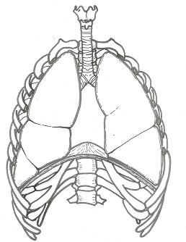
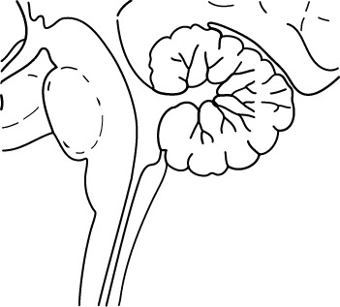
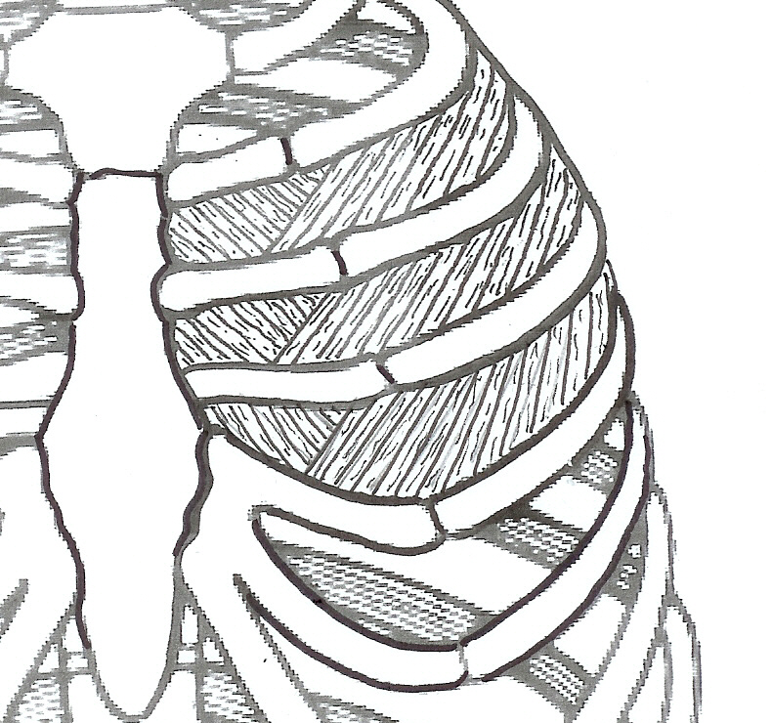
Control of normal breathing
Impulse to diaphragm & external intercostal muscles
INHALE
+
-
Inspiratory nucleus
Exspiratory nucleus
EXHALE
Medullary rhythmicity centre
Impulse to internal intercostal muscles

Slide 9
Regulation of forced breathing
Forced breathing
Inspiration
  Inspiratory nucleus activated/ expiratory nucleus suppressed
  Nerve impulses sent to respiratory muscles
  Inspiratory muscles contract/expiratory muscles relax
Expiration
  Expiratory nucleus activated/Inspiratory nucleus suppressed
  Nerve impulses sent to respiratory muscles
  Expiratory muscles contract/Inspiratory muscles relax

Slide 10
Respiratory reflexes
Normal breathing is modified by:
Changes in levels of oxygen & carbon dioxide
Changes in blood pressure
Stretch receptors in lungs
Irritants (sneezing, coughing etc.)
Sensations such as cold or pain

Slide 11
Effect of high CO₂/low O₂ on breathing
Stimulus - High CO₂ (= low pH or high H⁺) or low O₂
Receptor – Chemoreceptors
  Aorta - High CO₂ or low O₂
  Carotid artery – High CO₂ or low O₂
  Medulla oblongata - High CO₂ only
Control centre - Respiratory centres in brain stem
Transmission - Reflexes involving somatic nerves
Effector - Respiratory muscles
Response - Increased rate and depth of breathing

Slide 12
Negative feedback loop
Chemoreceptors
  Aorta
  Carotid artery
  Medulla oblongata
High CO2
(= low pH or high H+)
or low O2
Stimulus
Receptor
Respiratory centres in brain stem
Levels of CO2
& O2 return to normal
Control
centre
Feedback
Reflexes involving somatic nerves
Response
Effector
Increased rate and depth of breathing
Respiratory muscles

Slide 13
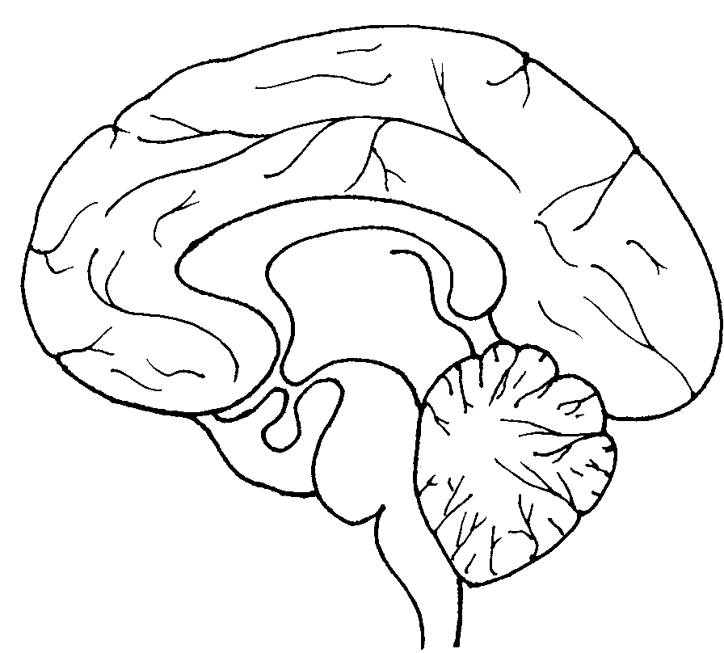
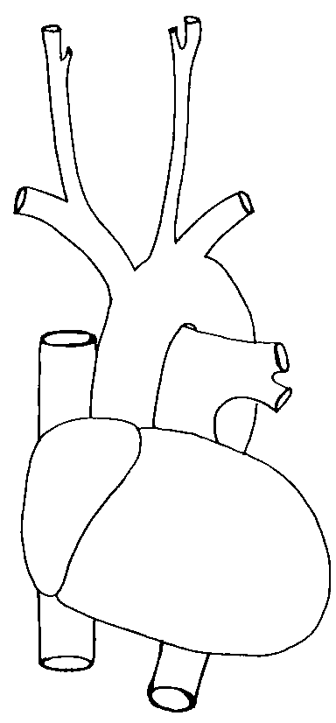
Respiratory reflexes
Sensory input from conscious area of the brain
Sensory input from other parts of the body
Sensory input from other parts of the body
Carbon dioxide and oxygen receptors
Respiratory centre
Nerve impulses to respiratory muscles

